Slide 1
Modelling Colombian Economy: Stock-Flow Consistent Prototype Growth Model
An adaptation from Yilmaz & Godin (2020).

Slide 2

Consumption Credit.
Households consumption is given by:
$$C_{H} = C_{H}^{d}+ {\dot{L}}_{H}^{D}$$
Households demand for domestic currency loans is:
$${\dot{L}}_{H}^{D}= θ_{0}+θ_{1}⋅{\left(C_{H}^{d}\right) }^{θ_{2}}$$
$$θ_{1}= 1−BUR$$
$$BUR= \frac{\left(rep + i_{H}^{L,D}\right)⋅ L_{H}^{D}}{\left(1−τ_{w}\right) ⋅ w ⋅ L}$$

Slide 3
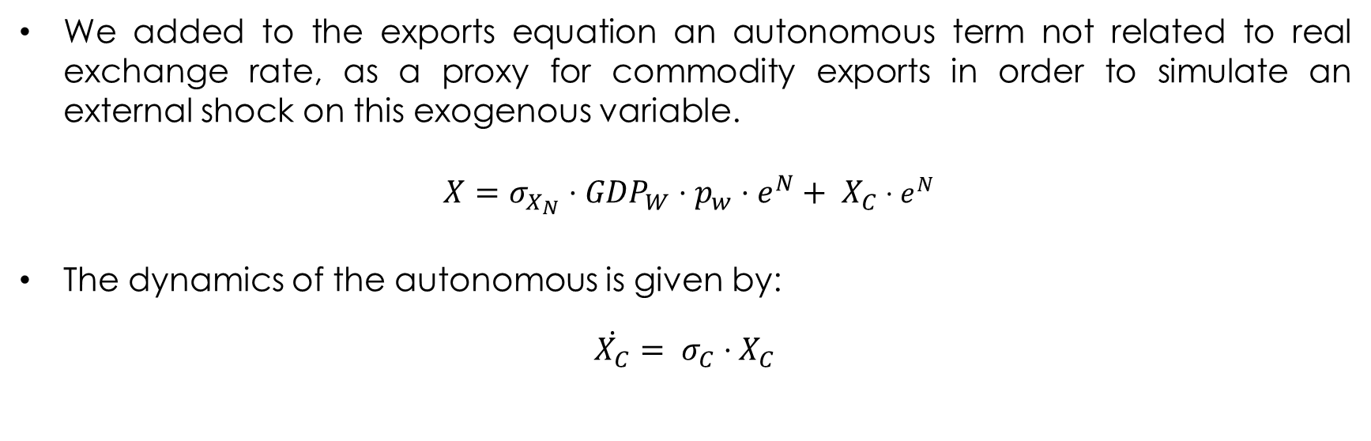
Exports.
We added to the exports equation an autonomous term not related to real exchange rate, as a proxy for commodity exports in order to simulate an external shock on this exogenous variable.
$X=σ_{X_{N}}⋅{GDP}_{W}⋅p_{w}⋅e^{N}+ X_{C}$ $⋅e^{N}$
The dynamics of the autonomous is given by:
$\dot{X_{C}}= σ_{C}⋅X_{C}$

Slide 4
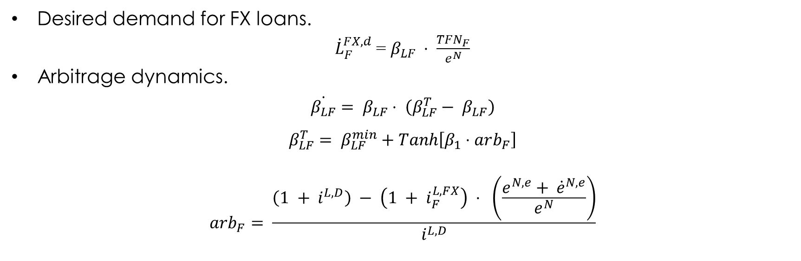
Firms FX loans – Demand.
Desired demand for FX loans.
${\dot{L}}_{F}^{FX,d}$ = $β_{LF} ⋅ \frac{TFN_{F}}{e^{N}}$
Arbitrage dynamics.
$$\dot{β_{LF}}= β_{LF}⋅ \left(β_{LF}^{T}− β_{LF}\right)$$
$$β_{LF}^{T}= β_{LF}^{min}+Tanh\left[β_{1}⋅arb_{F}\right]$$
$$arb_{F}= \frac{\left(1 + i^{L,D}\right) − \left(1 + i_{F}^{L,FX}\right) ⋅ \left(\frac{e^{N,e}+ {\dot{e}}^{N,e}}{e^{N}}\right)}{i^{L,D}}$$

Slide 5

Firms FX loans – Supply.
Credit rationing mechanism applied by the international banks:
${\dot{L}}_{B}^{FX,d}= {\dot{L}}_{F}^{FX,d}$
$${\dot{L}}_{B}^{FX}= {χ∙\dot{L}}_{B}^{FX,d}$$
$$χ= χ_{0}+χ_{1}∙NIIP+ χ_{2}∙\frac{\dot{GDP}}{GDP}$$
Interest rate on FX loans charged to the domestic banks
$i_{B}^{L,FX}= \left(1+θ\right)i^{W}$
$$θ= θ_{0}∙risk$$

Slide 6

Portfolio Flows – Option A.
Portfolio flows entering to the economy
$$WFF^{D}= ψ∙{\dot{B}}_{G}/e^{N}$$
$$ψ=ψ_{min}+ψ_{1}∙\left(r^{B,e}−r^{W, e}\right)$$
$$r_{G}^{B,e}= \frac{\left(1 +i_{G}^{B} \right)\left(1 − rsk\right)}{\left(\frac{e^{N,e} + {\dot{e}}^{N,e}}{e^{N}}\right)}$$
$$r^{W,e}=1+i_{G}^{W}$$
New Government bonds purchased by the rest of the world.
$${\dot{B}}_{G}^{W}=WFF^{D}∙e^{N}$$

Slide 7

Portfolio Flows – Option B.
Global portfolio flows.
$$WFF=Φ⋅GDP_{W}⋅p_{W}$$
Portfolio flows entering to the economy.
$$WFF^{D}=ψ_{WFF}⋅WFF$$
$$ψ_{WFF}=ψ_{min}+ψ_{1}∙\left(r^{B,e}−r^{W, e}\right)$$
$$r_{G}^{B,e}= \frac{\left(1 +i_{G}^{B} \right)\left(1 − rsk\right)}{\left(\frac{e^{N,e} + {\dot{e}}^{N,e}}{e^{N}}\right)}$$
$$r^{W,e}=1+i_{G}^{W}$$
New Government bonds purchased by the rest of the world.
$${\dot{B}}_{G}^{W}=WFF^{D}∙e^{N}$$

Slide 8
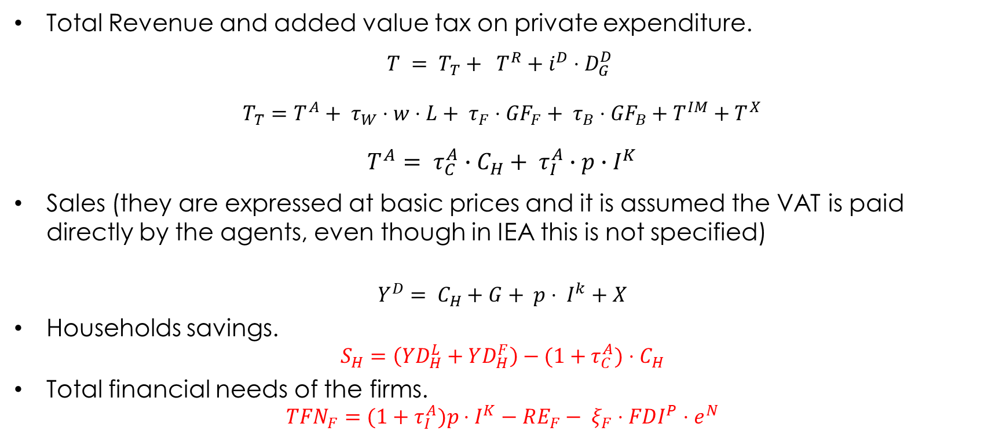
Government.
Total Revenue and added value tax on private expenditure.
$$T = T_{T}+ T^{R}+i^{D}⋅D_{G}^{D}$$
$T_{T}=T^{A}+ τ_{W}⋅w⋅L+ τ_{F}⋅{GF}_{F}+ τ_{B}⋅{GF}_{B}+T^{IM}+T^{X}$
$$T^{A}= τ_{C}^{A}∙C_{H}+ τ_{I}^{A}∙p∙I^{K}$$
Sales (they are expressed at basic prices and it is assumed the VAT is paid directly by the agents, even though in IEA this is not specified)
$$Y^{D}= C_{H}+G+ p⋅ I^{k}+X$$
Households savings.
$$S_{H}=\left(YD_{H}^{L}+YD_{H}^{F}\right)−(1+τ_{C}^{A})⋅C_{H}$$
Total financial needs of the firms.
$$TFN_{F}=(1+τ_{I}^{A})p⋅I^{K}−RE_{F}− ξ_{F}⋅FDI^{P}⋅e^{N}$$

Slide 9
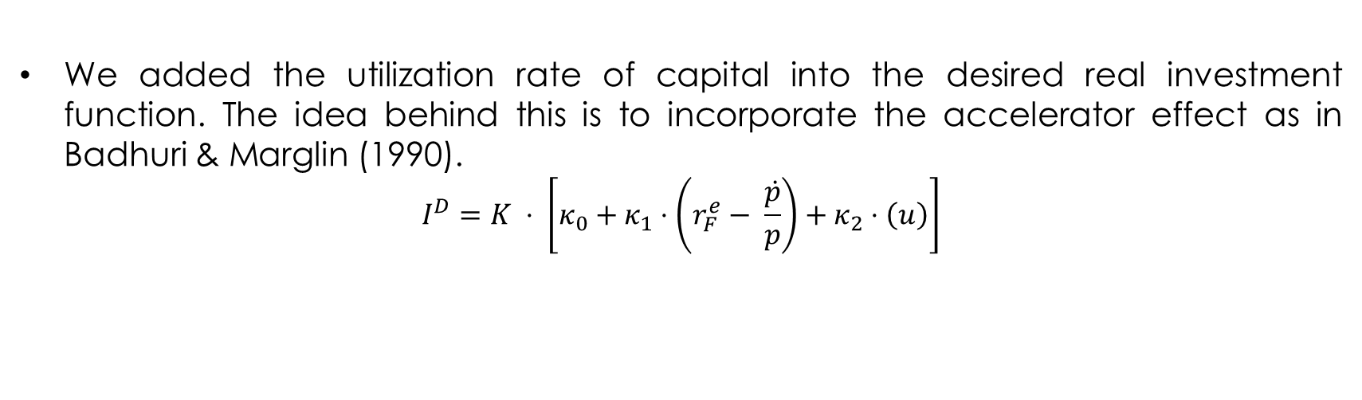
Investment.
We added the utilization rate of capital into the desired real investment function. The idea behind this is to incorporate the accelerator effect as in Badhuri & Marglin (1990).
$$I^{D}=K ⋅ \left[κ_{0}+κ_{1}⋅\left(r_{F}^{e}− \frac{\dot{p}}{p}\right)+κ_{2}⋅\left(u\right)\right]$$

Slide 10
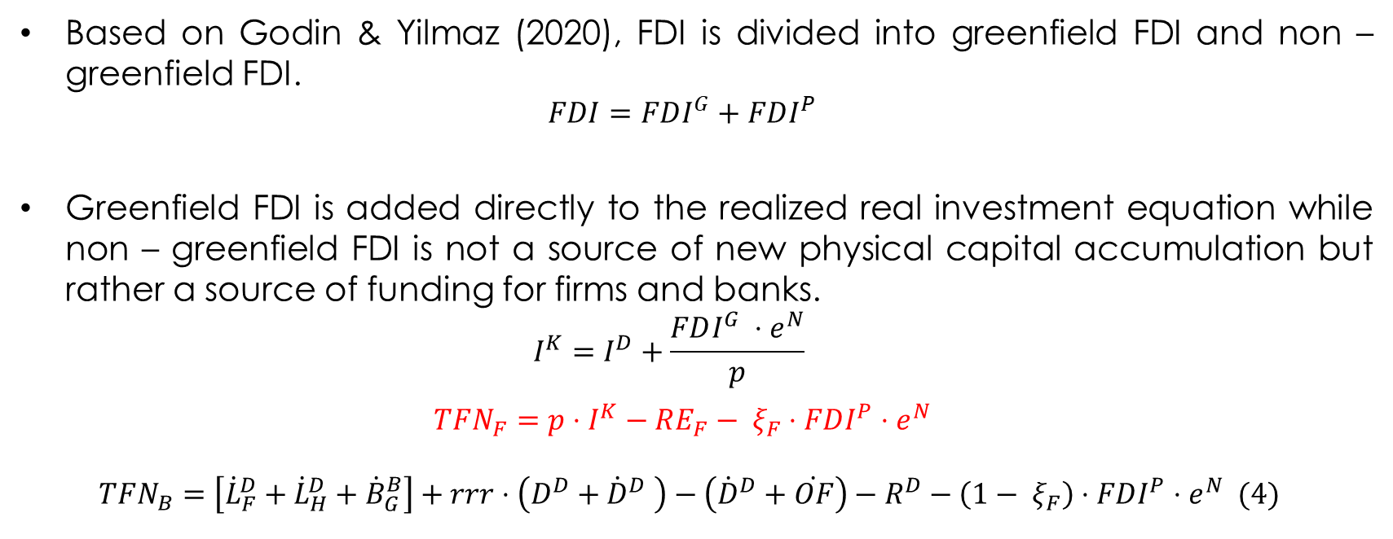
Foreign Direct Investment.
Based on Godin & Yilmaz (2020), FDI is divided into greenfield FDI and non – greenfield FDI.
$$FDI=FDI^{G}+FDI^{P}$$
Greenfield FDI is added directly to the realized real investment equation while non – greenfield FDI is not a source of new physical capital accumulation but rather a source of funding for firms and banks.
$$I^{K}=I^{D}+\frac{FDI^{G} ⋅e^{N}}{p}$$
$$TFN_{F}=p⋅I^{K}−RE_{F}− ξ_{F}⋅FDI^{P}⋅e^{N}$$
$$TFN_{B}=\left[{\dot{L}}_{F}^{D}+{\dot{L}}_{H}^{D}+{\dot{B}}_{G}^{B}\right]+rrr⋅\left(D^{D}+{\dot{D}}^{D} \right)−\left({\dot{D}}^{D}+\dot{OF}\right)−R^{D}−\left({1− ξ}_{F}\right)⋅FDI^{P}⋅e^{N} (4)$$

Slide 11
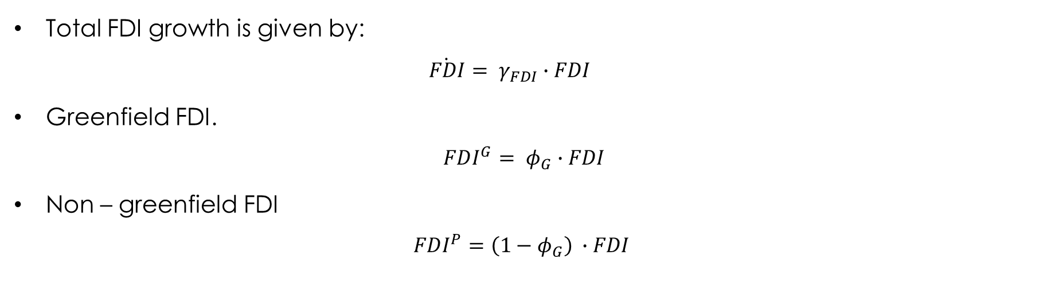
Foreign Direct Investment.
Total FDI growth is given by:
$$\dot{FDI}= γ_{FDI}∙FDI$$
Greenfield FDI.
$$FDI^{G}= φ_{G}∙FDI$$
Non – greenfield FDI
$$FDI^{P}=\left(1−φ_{G}\right) ∙FDI$$

Slide 12

Foreign Direct Investment.
Private equity accumulation by the rest of the world.
$${\dot{EQ}}_{w}= {\dot{EQ}}_{F}^{RoW}+ {\dot{EQ}}_{B}^{RoW}$$
Firm’s equities accumulation by the rest of the world.
$${\dot{EQ}}_{F}^{RoW}= ξ_{F}∙FDI^{P}∙e^{N}+FDI^{G}∙e^{N}$$
Bank’s equities accumulation by the rest of the world.
$${\dot{EQ}}_{B}^{RoW}=\left(1−ξ_{F}\right) ∙FDI^{P}∙e^{N}$$

Slide 13

Foreign Direct Investment.
Private equity accumulation by households.
$${\dot{EQ}}_{H}= {\dot{EQ}}_{F}^{H}+ {\dot{EQ}}_{B}^{H}$$
Firm’s equities accumulation by the households.
$${\dot{EQ}}_{F}^{H}=p∙I^{K}−TFN_{F}− {\dot{EQ}}_{F}^{RoW}=RE_{F}$$
$$TFN_{F}=EQ_{F}$$
$EQ_{F}$= ${\dot{EQ}}_{F}^{H}$ + ${\dot{EQ}}_{F}^{RoW}$
Bank’s equities accumulation by the households.
${\dot{EQ}}_{B}^{H}= … =RE_{B}$

Slide 14

Foreign Direct Investment.
The dividends paid to the rest of the world are distributed considering the ownership structure of firms and banks
$$Div_{F}^{RoW}=\left(\frac{EQ_{F}^{RoW}}{EQ_{F}}\right)∙\left(Div_{F}\right)$$
$$Div_{B}^{RoW}=\left(\frac{EQ_{B}^{RoW}}{EQ_{B}}\right)∙\left(Div_{B}\right)$$

Slide 15
Foreign Direct Investment.
The dividends paid to the rest of the world are distributed considering the ownership structure of firms and banks
$$Div_{F}^{RoW}=\left(\frac{EQ_{F}^{RoW}}{EQ_{F}}\right)∙\left(Div_{F}\right)$$
$$Div_{B}^{RoW}=\left(\frac{EQ_{B}^{RoW}}{EQ_{B}}\right)∙\left(Div_{B}\right)$$

Slide 16
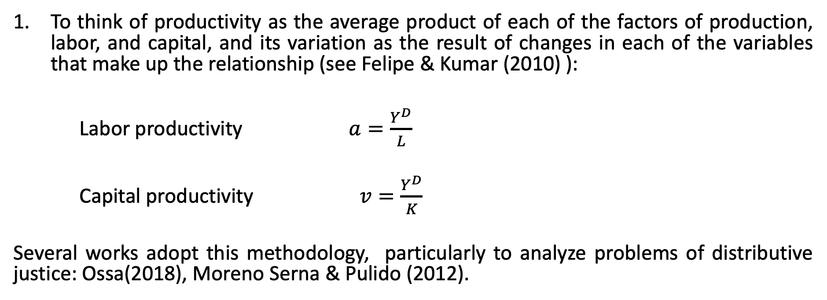
Approaches to defining productivity behaviour:
To think of productivity as the average product of each of the factors of production, labor, and capital, and its variation as the result of changes in each of the variables that make up the relationship (see Felipe & Kumar (2010) ):
Labor productivity $a=\frac{Y^{D}}{L}$
Capital productivity $v=\frac{Y^{D}}{K}$
Several works adopt this methodology, particularly to analyze problems of distributive justice: Ossa(2018), Moreno Serna & Pulido (2012).

Slide 17
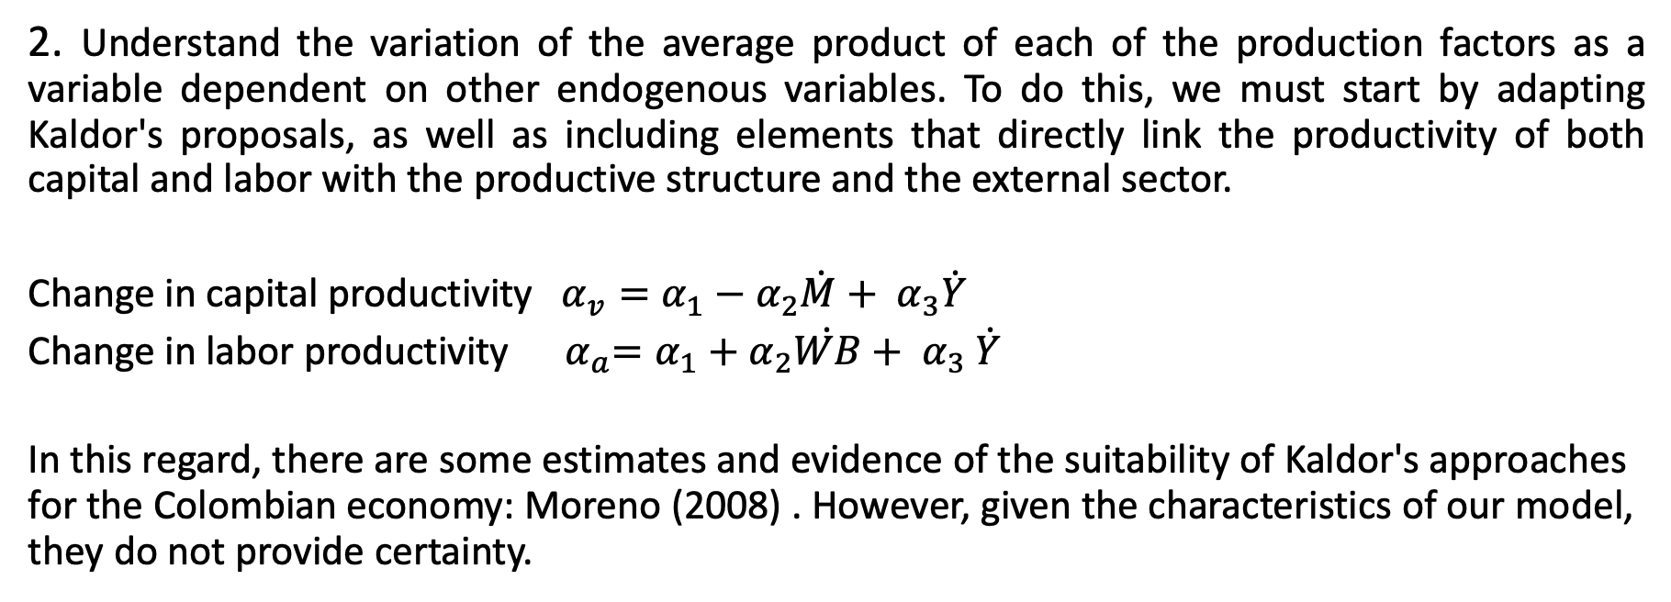
Approaches to defining productivity behaviour:
2. Understand the variation of the average product of each of the production factors as a variable dependent on other endogenous variables. To do this, we must start by adapting Kaldor's proposals, as well as including elements that directly link the productivity of both capital and labor with the productive structure and the external sector.
Change in capital productivity $α_{v}=α_{1}−α_{2}\dot{M}+ α_{3}\dot{Y}$
Change in labor productivity${ α}_{a}=α_{1}+α_{2}\dot{WB}+ α_{3} \dot{Y}$
In this regard, there are some estimates and evidence of the suitability of Kaldor's approaches for the Colombian economy: Moreno (2008) . However, given the characteristics of our model, they do not provide certainty.

Slide 18
References.
Bhaduri, Amit & Marglin, Stephen, (1990). "Unemployment and the Real Wage: The Economic Basis for Contesting Political Ideologies," Cambridge Journal of Economics, Oxford University Press, vol. 14(4), pages 375-393, December.
Caiani, Alessandro & Godin, Antoine & Caverzasi, Eugenio & Gallegati, Mauro & Kinsella, Stephen & Stiglitz, Joseph E., (2016). "Agent based-stock flow consistent macroeconomics: Towards a benchmark model," Journal of Economic Dynamics and Control, Elsevier, vol. 69(C), pages 375-408.
Dafermos, Yannis, 2012. "Liquidity preference, uncertainty, and recession in a stock-flow consistent model," Journal of Post Keynesian Economics, Taylor & Francis Journals, vol. 34(4), pages 749-776.
Felipe, J., & Kumar, U. (2010). Technical Change in India’s Organized Manufacturing Sector (SSRN Scholarly Paper ID 1691695). Social Science Research Network. https://doi.org/10.2139/ssrn.1691695
Moreno Rivas, Á. M. (2008, July 4). Las leyes del desarrollo económico endógeno de Kaldor: El caso colombiano. Revista de Economía Institucional. https://revistas.uexternado.edu.co//index.php/ecoins/article/view/70
Moreno Serna, R., & Pulido, Á. (2012). Tercerización laboral en el sector financiero y evolución salarial en Colombia.
Ossa, D. (2018). Productividad y distribución del ingreso: Implicaciones sobre el salario mínimo colombiano, 2001-2016 | Revista de Economía Institucional. https://revistas.uexternado.edu.co/index.php/ecoins/article/view/5449
Passarella, M. (2019). "From abstract to concrete: some tips for developing an empirical stockâ€“flow consistent model," European Journal of Economics and Economic Policies: Intervention, Edward Elgar Publishing, vol. 16(1), pages 55-93, April.
Pedrosa, I ; Biancarelli(2015).”Surges in capital inflows and the macroeconomic dynamics of peripheral economies- a stock-flow consistent model”.
Till van Treeck, (2007). "A Synthetic, Stock-Flow Consistent Macroeconomic Model of Financialisation," IMK Working Paper 06-2007, IMK at the Hans Boeckler Foundation, Macroeconomic Policy Institute.
Valdecantos, S. (2016).”Estructura productiva y vulnerabilidad externa- un modelo estructuralista stock-flujo consistente”

